Slide 1
Database Management Systems GYM MANAGEMENT SYSTEM
By
Arimanda Likhitha-2110030043
Kongara Pallavi sri-2110030089
Saireen-2110030105
T.Leekhitha Reddy-2110030140
Under the guidance of
DR. Sumit Hazra

Slide 2
Problem statement and domain
Create a web/online application for automated gym management in terms of tracking of payment receipts for members, distributing messages, etc.
In this gym management service, we propose appointment scheduling problems and various applications and solution approaches in healthcare systems.
The problems are based on the flow of people, personal preferences, and random arrival time and service.
What we plan to do is to provide the user with a solution to the problem they are facing. It has always fascinated me to imagine that we can get almost everything online then why can’t we get some trusted medical help using the same technology?
e a web/online application for automated gym management in terms of tracking of payment receipts for members, distributing messages, etc. Create a web/online application for automated gym management in terms of tracking of payment receipts for members, distributing messages, etc.

Slide 3
Existing solutions/ Naïve solutions
The main objective of the project is to develop software that facilitates data storage, data maintenance, and retrieval for the gym in an igneous way.
To store the record of the customers, the staff has the privileges to access, modify and delete any record, and finally the service, the gym provides to its customers.
Also, only the staff has the privilege to access any database and make the required changes, if necessary.
To develop easy-to-use software which handles the customer-staff relationship effectively.
To develop a user-friendly system that requires minimal user training. Most of the features and functions are similar to those on any windows platform.

Slide 4
Solutions
24 hr site availability
Query column
Details of the gym
Location
Photos of the gym
costs

Slide 5
Proposed Algorithm Design Technique
Brute-force or exhaustive search.
Divide and Conquer.
Greedy Algorithms.
Dynamic Programming.
Branch and Bound Algorithm.
Randomized Algorithm.
Backtracking.
Flow charts, graphs, diagrams, Pie charts

Slide 6
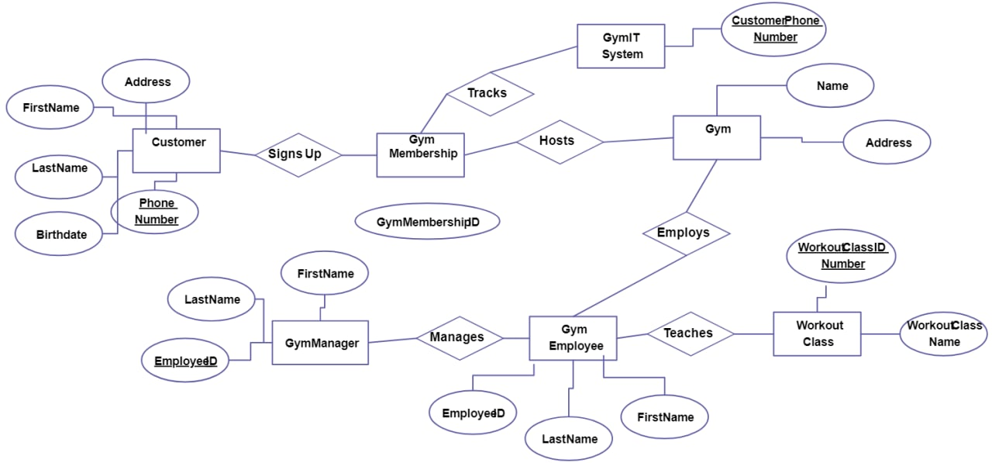
ER DIAGRAM

Slide 7
TOOLS REQUIRED
TerraER
PYCHARM
GITHUB

Slide 8
Data Structures needed
Arrays
Linked list
Stack
Queue
Hash Table
Trees
Graphs

Slide 9
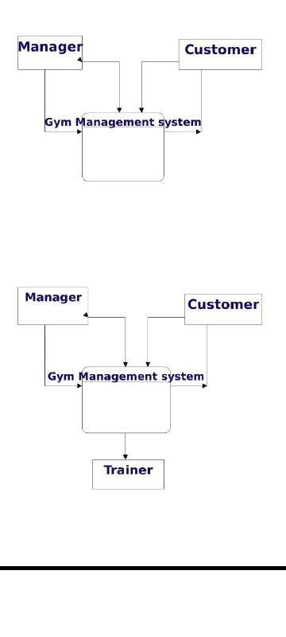
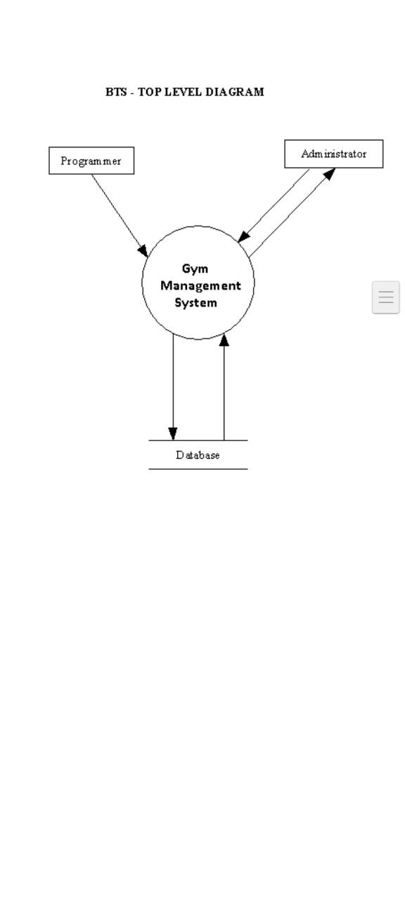

Slide 10
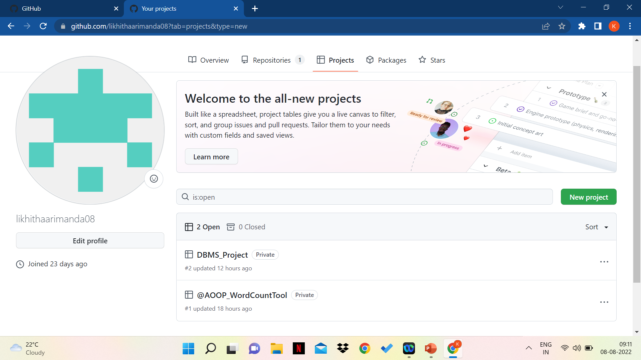
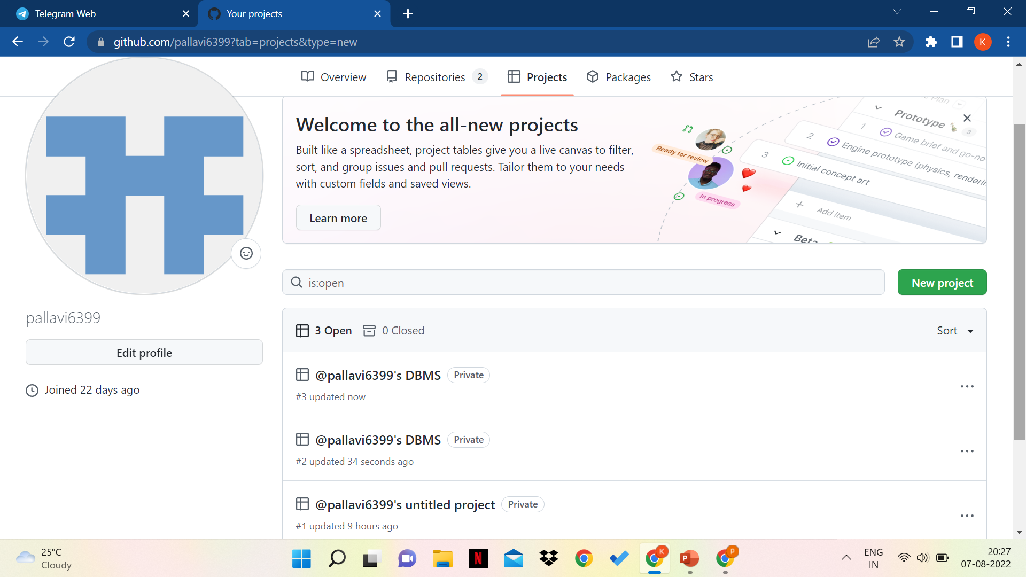
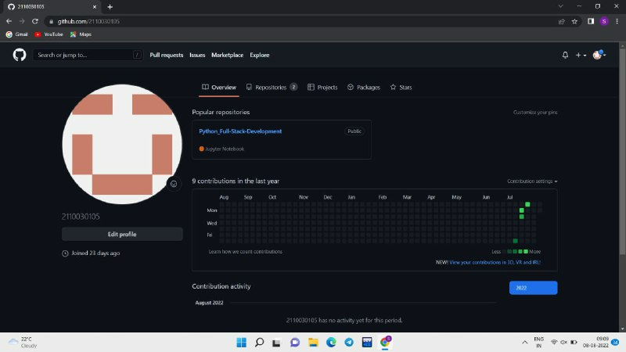
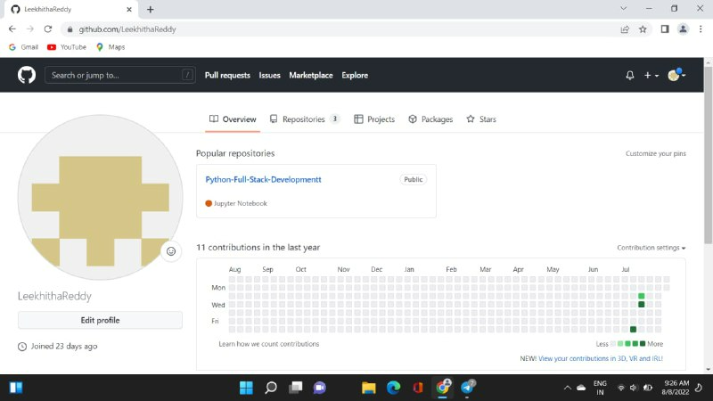
Github setup

Slide 11
Division of work among the group members
2110030043-data structure, code
2110030089-ER diagrams, presentation ppt, Algo
2110030105- ER diagrams, programming
2110030140-solutions,code

